Slide 1
Chapter 4 Local Area network

Slide 2
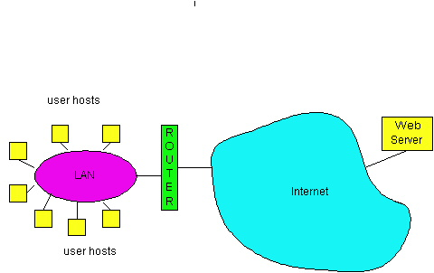
LAN technologies
Data link layer so far:
services, error detection/correction, multiple access
Next: LAN technologies
LAN model
addressing
Ethernet
hubs, switches
802.11
802.15

Slide 3
Keypoints and Difficulties
Keypoints:
LAN model
Ethernet
Hubs, switches
Wireless LAN-IEEE 802.11
Difficulties:
The minimum frame length
The exponential Backoff algorithm
CSMA/CA

Slide 4
LAN model
Network
layer
Logical Link Control
Provide the connection environment to the upper level
LLC sub layer
Data link
layer
MAC sub layer
Providing media access to the lower layer
Physical
layer
Media Access Control

Slide 5
LAN model
The following LAN is invisible
for LLC sub layer
Network
layer
Network
layer
Logic link
control
LLC
LLC
Data link
layer
Media access
control
MAC
Local area
network
MAC
Physical
layer
Physical
layer
node 1
node 2
For the same LLC, several MAC options may be provided.

Slide 6
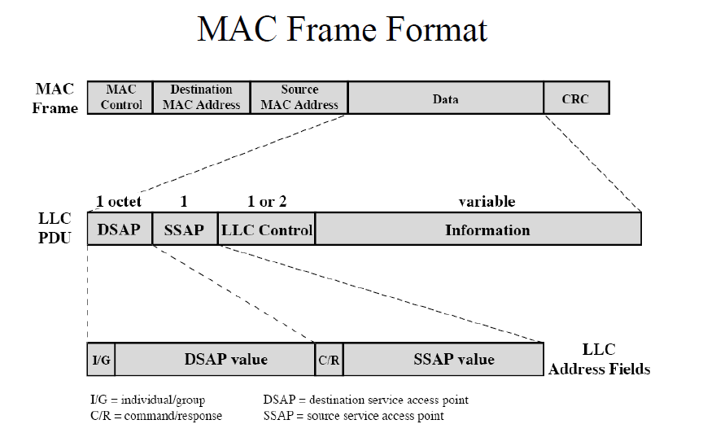
LLC and MAC

Slide 7
IEEE 802 working group
802.1A
802.1D Bridge
802.2 LLC
LLC
802.3
CSMA/CD
802.4
Token
Bus
802.5
Token
ring
802.6
DBDQ
802.8
FDDI
……
MAC
PHY

Slide 8
LAN Addresses
32-bit IP address:
network-layer address
used to get datagram to destination network
LAN (or MAC or physical) address:
used to get datagram from one interface to another physically-connected interface (same network)
48 bit MAC address (for most LANs) burned in the adapter ROM

Slide 9
LAN Address (more)
MAC address allocation administered by IEEE
manufacturer buys portion of MAC address space (to assure uniqueness)
Analogy:
(a) MAC address: like Social Security Number
(b) IP address: like postal address
MAC flat address => portability
can move LAN card from one LAN to another
IP hierarchical address NOT portable
depends on network to which one attaches

Slide 10
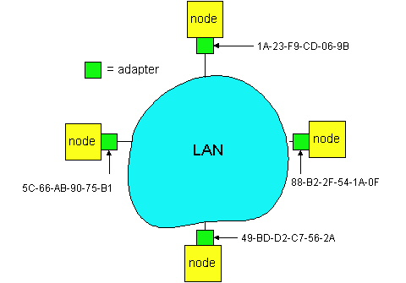
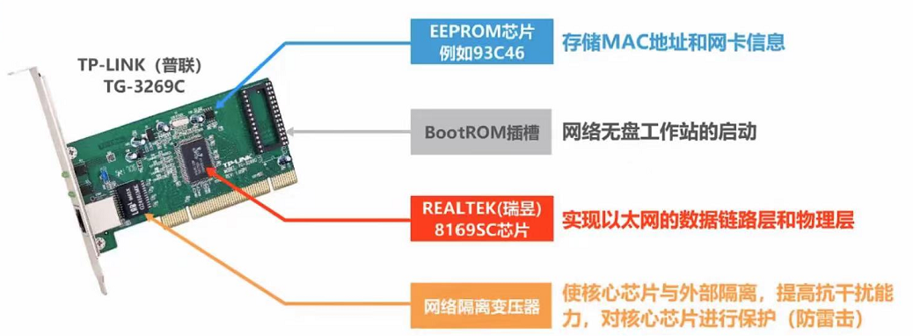
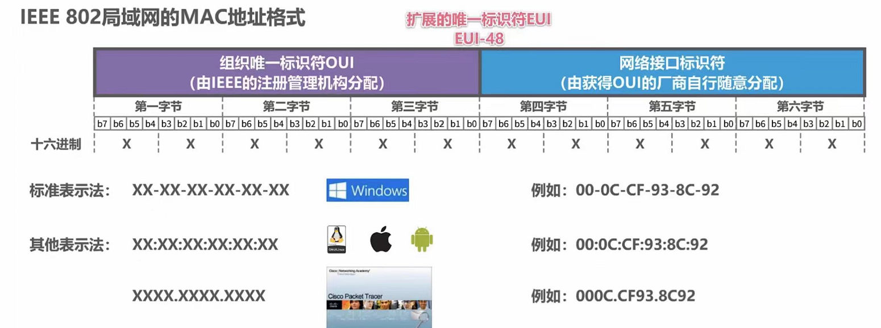
LAN Address
Each adapter on LAN has unique LAN address

Slide 11
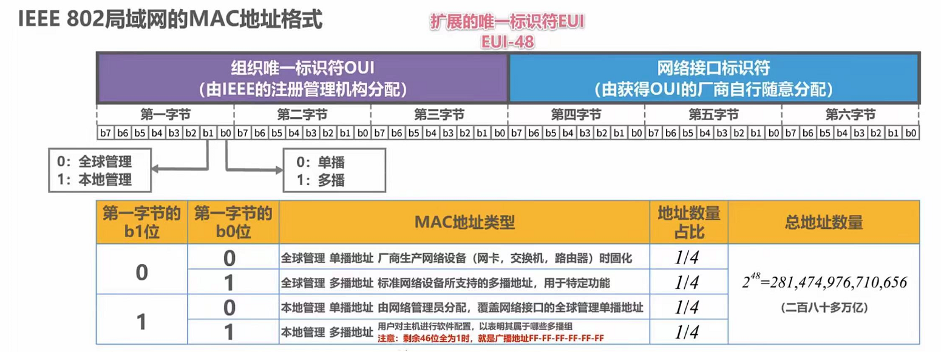
MAC Addresses
https://standards-oui.ieee.org/oui/oui.txt
MAC地址查询 - https://mac.bmcx.com/
What is the random MAC address technology?

Slide 12
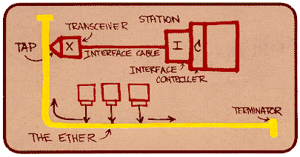
Ethernet
“dominant” LAN technology:
cheap $20 for 100Mbs!
first wildey used LAN technology
Simpler, cheaper than token LANs and ATM
Kept up with speed race: 10, 100, 1000 Mbps
Metcalfe’s Etheret
sketch

Slide 13



Ethernet: physical topology
bus: popular through mid 90s
all nodes in same collision domain (can collide with each other)
star: prevails today
active switch in center
each “spoke” runs a (separate) Ethernet protocol (nodes do not collide with each other)
switch
star
bus: coaxial cable

Slide 14
Ethernet: unreliable, connectionless
connectionless: no handshaking between sending and receiving NICs
unreliable: receiving NIC doesn't send acks or nacks to sending NIC
data in dropped frames recovered only if initial sender uses higher layer rdt (e.g., TCP), otherwise dropped data lost
Ethernet’s MAC protocol: unslotted CSMA/CD with binary backoff

Slide 15
802.3 Ethernet standards: link & physical layers
many different Ethernet standards
common MAC protocol and frame format
different speeds: 10 Mbps, 100 Mbps, 1Gbps, 10 Gbps, 40 Gbps
different physical layer media: fiber, cable
application
transport
network
link
physical
MAC protocol
and frame format
100BASE-TX
100BASE-T2
100BASE-FX
100BASE-T4
100BASE-SX
100BASE-BX
copper (twister
pair) physical layer
fiber physical layer

Slide 16
Ethernet Frame Structure
IP datagrame
IP layer
byte
6
6
2
46 ~ 1500
4
MAC frame
Destination
address
Source
address
type
data
FCS
MAC layer
inserting
Ethernet MAC frame
Physical
layer
8 byte
7 byte
1 byte
…
10101010101010 10101010101010101011
Preamble field
Start of Frame Delimiter ; SFD

Slide 17

Ethernet Frame Structure
Sending adapter encapsulates IP datagram (or other network layer protocol packet) in Ethernet frame
Preamble:
7 bytes with pattern 10101010 followed by one byte with pattern 10101011
used to synchronize receiver, sender clock rates

Slide 18
Ethernet Frame Structure (more)
Addresses: 6 bytes, frame is received by all adapters on a LAN and dropped if address does not match
Type: 2 bytes, indicates the higher layer protocol, mostly IP but others may be supported such as Novell IPX and AppleTalk)
CRC: 4 bytes, checked at receiver, if error is detected, the frame is simply dropped

Slide 19
Ethernet Frame Structure (more)
Data: 46~1500 bytes
Minimum frame length: 64 bytes, why? (contention period 2τ is 51.2 μs for IEEE 802.3, R=10Mbps)
Maximum frame length: 1518 bytes, why?

Slide 20
Exercises-1
In a LAN using CSMA / CD protocol, the transmission medium is a complete cable, the transmission rate is 1Gbps, and the signal propagation rate in the cable is 200000 km / s. if the minimum data frame length is reduced by 800 bits, the distance between the farthest two stations needs to be at least
(1) increased by 160m (2) increased by 80m (3) reduced by 160m (4) reduced by 80m

Slide 21
Ethernet: uses CSMA/CD
A: sense channel, if idle
then {
transmit and monitor the channel;
If detect another transmission
then {
abort and send jam signal;
update # collisions;
delay as required by exponential backoff algorithm;
goto A
}
else {done with the frame; set collisions to zero}
}
else {wait until ongoing transmission is over and goto A}

Slide 22

Ethernet: uses CSMA/CD

Slide 23
Ethernet’s CSMA/CD (more)
Jam Signal: make sure all other transmitters are aware of collision; 48 bits;
A
B
for A, a conflict
is detected
B sending a packet
τ
T_{B}
Channel
Occupation
time
t
collision
T_{J}
for B, a conflict
is detected
Jamming signal
τ

Slide 24
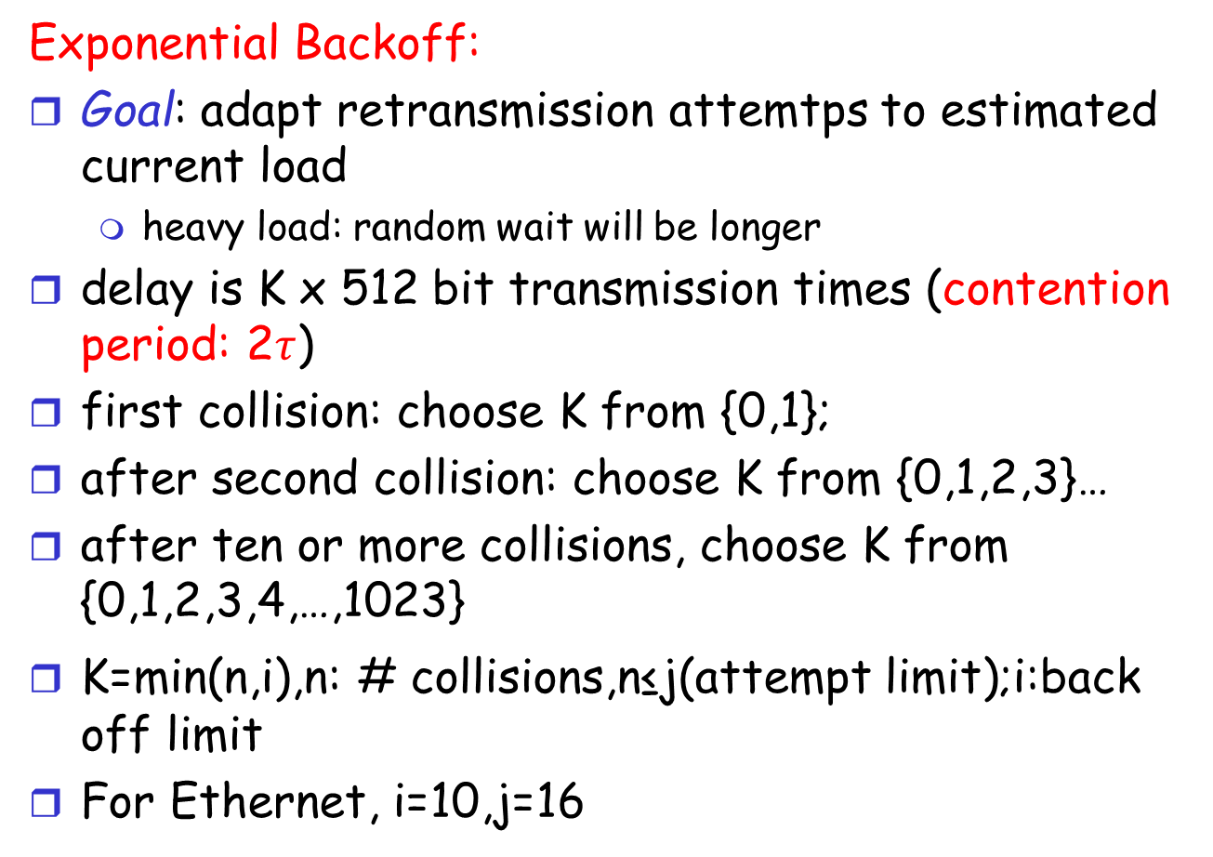
Ethernet’s CSMA/CD (more)
Exponential Backoff:
Goal: adapt retransmission attemtps to estimated current load
heavy load: random wait will be longer
delay is K x 512 bit transmission times (contention period: 2$τ$)
first collision: choose K from {0,1};
after second collision: choose K from {0,1,2,3}…
after ten or more collisions, choose K from {0,1,2,3,4,…,1023}
K=min(n,i),n: # collisions,n≤j(attempt limit);i:back off limit
For Ethernet, i=10,j=16
Notes:
使等待的时间随重传次数增大，以减小发送碰撞的概率，有利于系统的稳定，但公平性不好

Slide 25
Interconnecting LANs
Q: Why not just one big LAN?
Limited amount of supportable traffic: on single LAN, all stations must share bandwidth
limited length: 802.3 specifies maximum cable length
large “collision domain” (can collide with many stations)

Slide 26
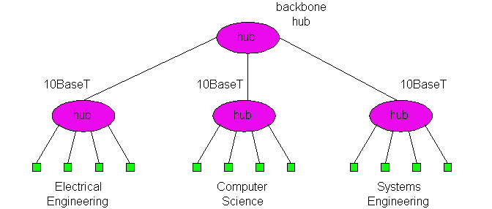
Hubs
Physical Layer devices: essentially repeaters operating at bit levels: repeat received bits on one interface to all other interfaces
Hubs can be arranged in a hierarchy (or multi-tier design), with backbone hub at its top

Slide 27
Hubs (more)
Each connected LAN referred to as LAN segment
Hubs do not isolate collision domains: node may collide with any node residing at any segment in LAN
Hub Advantages:
simple, inexpensive device
Multi-tier provides graceful degradation: portions of the LAN continue to operate if one hub malfunctions
extends maximum distance between node pairs (100m per Hub)

Slide 28
Hub limitations
single collision domain results in no increase in max throughput
multi-tier throughput same as single segment throughput
individual LAN restrictions pose limits on number of nodes in same collision domain and on total allowed geographical coverage
cannot connect different Ethernet types (e.g., 10BaseT and 100baseT)

Slide 29
Ethernet switch
link-layer device: takes an active role
store, forward Ethernet frames
examine incoming frame’s MAC address, selectively forward frame to one-or-more outgoing links when frame is to be forwarded on segment, uses CSMA/CD to access segment
transparent
hosts are unaware of presence of switches
plug-and-play, self-learning
switches do not need to be configured

Slide 30
Switch: multiple simultaneous transmissions
hosts have dedicated, direct connection to switch
switches buffer packets
Ethernet protocol used on each incoming link, but no collisions; full duplex
each link is its own collision domain
switching: A-to-A’ and B-to-B’ can transmit simultaneously, without collisions
A
C’
B
6
1
2
5
4
3
B’
C
A’
switch with six interfaces
(1,2,3,4,5,6)

Slide 31
Switch forwarding table
Q: how does switch know A’ reachable via interface 4, B’ reachable via interface 5?
A
C’
B
6
1
2
A: each switch has a switch table, each entry:
(MAC address of host, interface to reach host, time stamp)
looks like a routing table!
5
4
3
B’
C
A’
switch with six interfaces
(1,2,3,4,5,6)
Q: how are entries created, maintained in switch table?
something like a routing protocol?

Slide 32
Switch: self-learning
Source: A
Dest: A’
switch learns which hosts can be reached through which interfaces
when frame received, switch “learns” location of sender: incoming LAN segment
records sender/location pair in switch table
A
A A’
C’
B
6
1
2
5
4
3
B’
C
A’
MAC addr interface TTL
A
1
60
Switch table
(initially empty)

Slide 33
Switch: frame filtering/forwarding
when frame received at switch:
1. record incoming link, MAC address of sending host
2. index switch table using MAC destination address
3. if entry found for destination then {
if destination on segment from which frame arrived then drop frame
else forward frame on interface indicated by entry
}
else flood /* forward on all interfaces except arriving
interface */

Slide 34
Self-learning, forwarding: example
Source: A
Dest: A’
A
A A’
frame destination, A’, location unknown:
flood
C’
B
destination A location known:
6
1
2
A A’
A A’
A A’
A A’
A A’
5
4
3
selectively send on just one link
B’
C
A’ A
A’
MAC addr interface TTL
A
1
60
switch table
(initially empty)
A’
4
60

Slide 35

Interconnecting switches
self-learning switches can be connected together:
S₄
S₁
S₃
A
S₂
F
I
B
C
D
E
G
H
Q: sending from A to G - how does S₁ know to forward frame destined to G via S₄ and S₃?
A: self learning! (works exactly the same as in single-switch case!)

Slide 36
Self-learning multi-switch example
Suppose C sends frame to I, I responds to C
S₄
S₁
S₃
A
S₂
F
I
B
C
D
E
G
H
Q: show switch tables and packet forwarding in S₁, S₂, S₃, S₄

Slide 37
Institutional network
mail server
to external
network
router
web server
IP subnet

Slide 38
Switches vs. routers
application
transport
network
link
physical
both are store-and-forward:
routers: network-layer devices (examine network-layer headers)
switches: link-layer devices (examine link-layer headers)
both have forwarding tables:
routers: compute tables using routing algorithms, IP addresses
switches: learn forwarding table using flooding, learning, MAC addresses
datagram
frame
link
physical
frame
switch
network
link
physical
datagram
frame
application
transport
network
link
physical

Slide 39


VLANs: motivation
consider:
CS user moves office to EE, but wants connect to CS switch?
single broadcast domain:
all layer-2 broadcast traffic (ARP, DHCP, unknown location of destination MAC address) must cross entire LAN
security/privacy, efficiency issues
Computer
Science
Computer
Engineering
Electrical
Engineering

Slide 40
VLANs
port-based VLAN: switch ports grouped (by switch management software) so that single physical switch ……
Virtual Local
Area Network
1
7
9
15
2
8
10
16
switch(es) supporting VLAN capabilities can be configured to define multiple virtual LANS over single physical LAN infrastructure.
…
…
Electrical Engineering
(VLAN ports 1-8)
Computer Science
(VLAN ports 9-15)
… operates as multiple virtual switches
1
7
9
15
2
8
10
16
…
…
Electrical Engineering
(VLAN ports 1-8)
Computer Science
(VLAN ports 9-16)

Slide 41
Port-based VLAN
router
traffic isolation: frames to/from ports 1-8 can only reach ports 1-8
can also define VLAN based on MAC addresses of endpoints, rather than switch port
1
7
9
15
2
8
10
16
dynamic membership: ports can be dynamically assigned among VLANs
…
…
Electrical Engineering
(VLAN ports 1-8)
Computer Science
(VLAN ports 9-15)
forwarding between VLANS: done via routing (just as with separate switches)
in practice vendors sell combined switches plus routers

Slide 42
VLANS spanning multiple switches
1
7
9
15
1
3
5
7
2
8
10
16
2
4
6
8
…
…
Electrical Engineering
(VLAN ports 1-8)
Computer Science
(VLAN ports 9-15)
Ports 2,3,5 belong to EE VLAN
Ports 4,6,7,8 belong to CS VLAN
trunk port: carries frames between VLANS defined over multiple physical switches
frames forwarded within VLAN between switches can’t be vanilla 802.1 frames (must carry VLAN ID info)
802.1q protocol adds/removed additional header fields for frames forwarded between trunk ports

Slide 43
802.1Q VLAN frame format
type
preamble
dest.
address
source
address
data (payload)
CRC
802.1 frame
type
preamble
dest.
address
source
address
data (payload)
CRC
802.1Q frame
2-byte Tag Protocol Identifier
(value: 81-00)
Recomputed
CRC
Tag Control Information (12 bit VLAN ID field,
3 bit priority field like IP TOS)

Slide 44
Wireless communications
the challenges of wireless communications
wireless communication standards
IEEE 802.11
IEEE 802.15.4
5G?

Slide 45
the challenges of Wireless communications
fading: path loss, multipath effect, shadow effect, Doppler effect
interference: from other wireless communications
hidden terminal problem
security
mobility

Slide 46
Wireless communication technology
Data rate
1 Gb/s
100 Mb/s
10 Mb/s
1 Mb/s
100 kb/s
10 kb/s
802.15.3
UWB
Wi-Fi
4G
Mobile communication
802.11g, a
WiMAX
802.16
802.11b
802.15.1
Blue-tooth
3G
Mobile communication
802.15.4
ZigBee
2G
Mobile communication
PAN LAN MAN WAN
Transmission range

Slide 47
IEEE Wireless Technology
802.11a
WiFi5
Local wireless networks
WLAN 802.11
802.11i/e/f/n/s…
802.11b
802.11g
WiFi
ZigBee
Personal wireless networks
WPAN 802.15
802.15.4
802.15.3
UWB
802.15.1
Bluetooth
WMAN 802.16 (Broadband Wireless Access)
WiMAX
+ Mobility
WiBro, 802.20

Slide 48
infrastructure vs. ad-hoc networks
infrastructure network
AP: Access Point
AP
AP
wired network
AP
ad-hoc network

Slide 49
IEEE standard 802.11
fixed
terminal
mobile terminal
infrastructure
network
access point
application
application
TCP
TCP
IP
IP
LLC
LLC
LLC
802.11 MAC
802.11 MAC
802.3 MAC
802.3 MAC
802.11 PHY
802.11 PHY
802.3 PHY
802.3 PHY

Slide 50
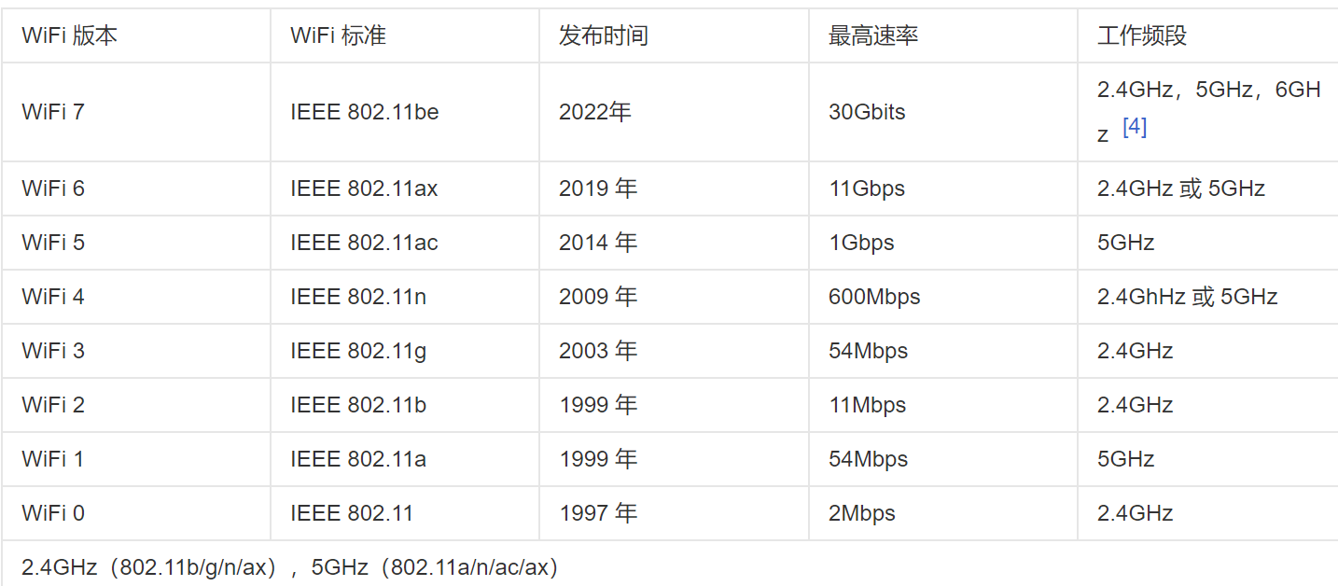
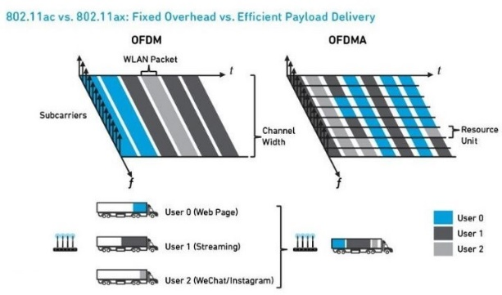
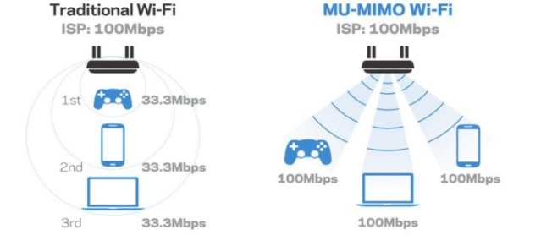
IEEE 802.11 physical layer
WiFi 6
OFDMA
MU-MIMO
1024-QAM
Spatial Reuse & BBS Coloring
Notes:
Spatial Reuse 空分复用
对于给定的调制方案，SNR越高，BER越低
对于给定的SNR，具有较高比特传输率的调制技术将具有较高的BER

Slide 51
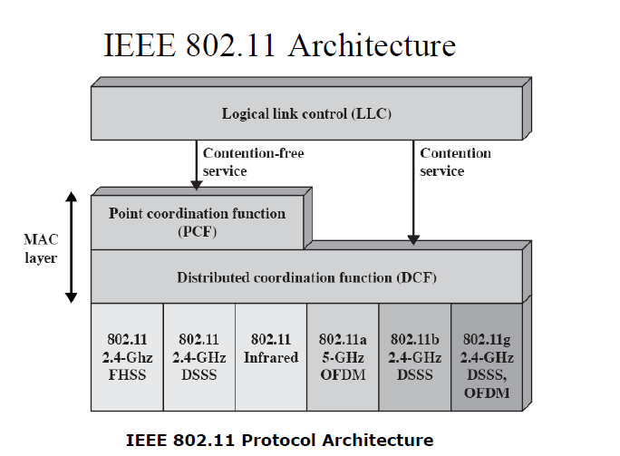
IEEE 802.11 protocol architecture

Slide 52
802.11 - MAC layer
Traffic services
Asynchronous Data Service (mandatory)
implemented using DCF (Distributed Coordination Function)
Time-Bounded Service (optional)
implemented using PCF (Point Coordination Function)
Access methods
DCF CSMA/CA (mandatory)
Distributed Wireless MAC
collision avoidance via randomized „back-off“ mechanism
minimum distance between consecutive packets
ACK packet for acknowledgements (not for broadcasts)
DCF w/ RTS/CTS (optional)
avoids hidden terminal problem
PCF (optional)
access point polls terminals
Contention free

Slide 53
802.11 MAC functions
MAC layer covers three functional areas:
Reliable data delivery
ACK-based scheme for reliability (receiver sends ACK after each successful transmission)
Medium access control
CSMA/CA; collision avoidance, not collision detection, Why? How?
Security
Wired Equivalent Privacy (WEP),WEP relies on a secret key being shared by end hosts and APs

Slide 54
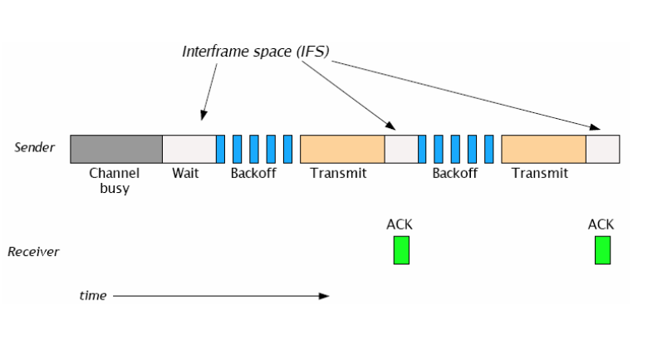
DCF CSMA/CA Illustrated

Slide 55
802.11 - MAC
Priorities
defined through different inter frame spaces
SIFS (Short Inter Frame Spacing) :
10μs (802.11b/g), 16 μs (802.11a)
High priority, for ACK, CTS, polling response
PIFS (PCF IFS) :
PIFS = SIFS + Slot time, which is 20 μs 802.11b, 9 μs 802.11a/g
medium priority, for time-bounded service using PCF
DIFS (DCF IFS):
DIFS = PIFS + Slot time
lowest priority, for asynchronous data service
DIFS
DIFS
PIFS
medium busy
SIFS
contention
next frame
direct access if medium is free ≥ DIFS
t

Slide 56
CSMA/CA access method
contention window
(randomized back-off mechanism)
DIFS
DIFS
medium busy
next frame
t
slot time
station ready to send starts sensing the medium (Carrier Sense based on CCA, Clear Channel Assessment)
if the medium is free for the duration of an Inter-Frame Space (IFS), the station can start sending (IFS depends on service type)
if the medium is busy, the station has to wait for a free IFS, then the station must additionally wait a random back-off time (collision avoidance, multiple of slot-time)
Slot time = 20 μs for 802.11b, 9 μs in 802.11a/g
CW_min = 16 for 802.11a, 32 for 802.11b
CW_max = 1024
Notes:
12

Slide 57
CSMA/CA access method (Continued)
If another station occupies the medium during the back-off time of the station, the back-off timer stops (fairness)
When back-off timer reaches zero, start transmission
If more than one nodes decrement to zero at the same time, a collision will occur.
If a collision occurs (missing ACK), the corresponding nodes double the CW size and choose their back-off time from the increase CW
After successful transmission, CW size is reset to its min value.

Slide 58
A simplified example
DIFS
DIFS
DIFS
DIFS
CW
A
frame
t
frozen
frozen
frozen
B
frame
t
backoff
frame
CW
C
t
backoff
frozen
CW
D
frame
t
backoff
frozen
CW
E
frame
t
backoff
frozen residual backoff time

Slide 59

LAN hidden terminal problem
A transmission range
C transmission range
A
B
C
D
A and C cannot hear each other and think B is idle, then, they both send data to B. A collision appears at the destination, B.

Slide 60

LAN exposed terminal problem
B transmission range
C transmission range
？
A
B
C
D
B is sending data to A. At the same time, C hopes to communication with D. But C senses a signal in the medium and dare not send the data.

Slide 61
RTS/CTS
Sending unicast packets
station can send RTS with reservation parameter after waiting for DIFS (reservation determines amount of time the data packet needs the medium)
acknowledgement via CTS after SIFS by receiver (if ready to receive)
other stations store medium reservations distributed via RTS and CTS
Two (potentially different) NAV groups
DIFS
RTS
data
sender
SIFS
SIFS
SIFS
CTS
ACK
receiver
NAV (RTS)
DIFS
other
stations
data
NAV (CTS)
t
defer access
contention

Slide 62



Collision Avoidance: RTS-CTS exchange
A
B
AP
RTS(B)
RTS(A)
reservation collision
RTS(A)
CTS(A)
CTS(A)
DATA (A)
defer
time
ACK(A)
ACK(A)

Slide 63
RTS/CTS (Continued)
Avoid hidden terminal problems
Also, reduce bandwidth waste by collisions
Data frame can be as large as 2300bytes
RTS = 20bytes, CTS = 14bytes
The bigger is the data frame, the more advantageous
Price : extended delay and more resource consumption!
RTS threshold
Enable RTS/CTS for frames which are bigger than RTS threshold
Each node’s decision

Slide 64
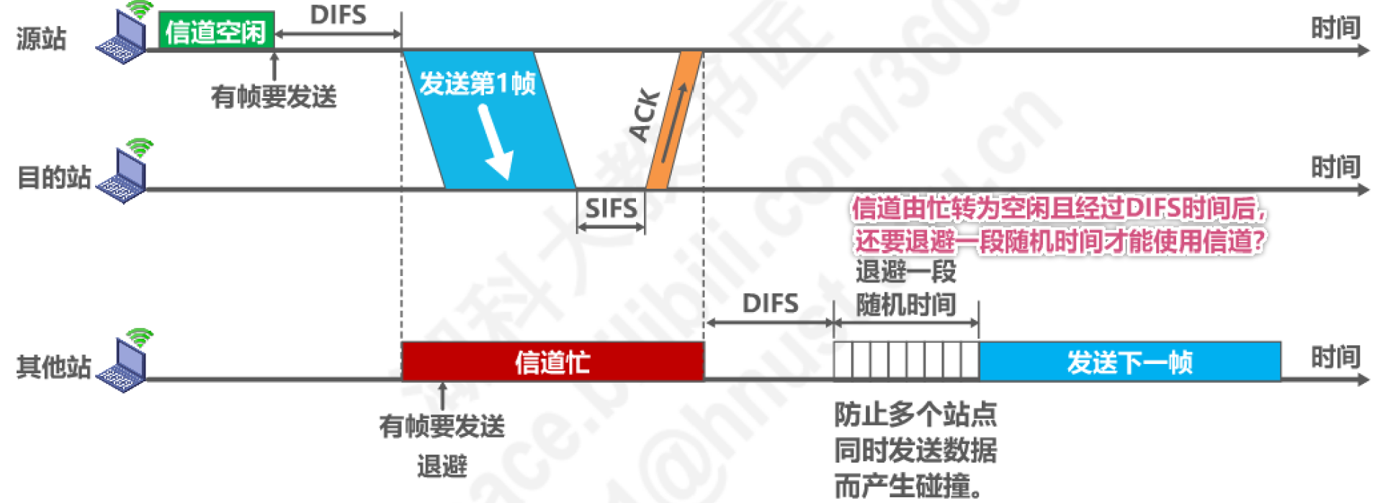
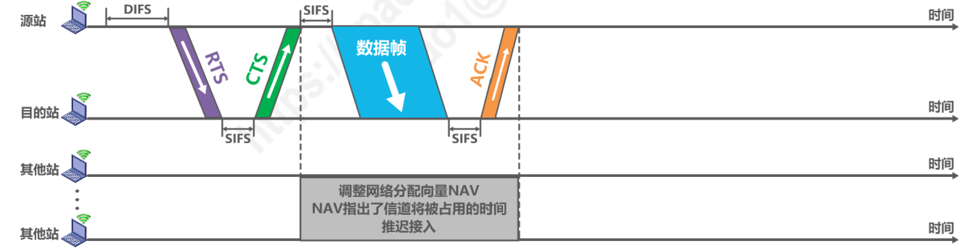
CSMA/CA access method
Notes:
12
如何降低冲突的概率：
1）增加不同优先级的帧间间隔时间，信道空闲时间必须大于IFS才能发送，保证高优先级帧优先发送而不和低优先级帧冲突；
2）信号由忙变为空闲且经过DIFS后，还要退避一段随机时间才能使用信道，以减少冲突可能性
3）使用RTS/CTS信道预约和虚拟载波监听机制（通过NAV：Network allocation vector网络分配向量），尽可能较少由于隐藏终端带来的冲突问题

Slide 65
802.11 frame: addressing
2
2
6
6
6
2
6
0 - 2312
4
frame
control
duration
address
1
address
2
address
3
seq
control
address
4
payload
CRC
Address 4: used only in ad hoc mode
Address 1: MAC address
of wireless host or AP
to receive this frame
Address 3: MAC address
of router interface to which AP is attached
Address 2: MAC address
of wireless host or AP
transmitting this frame

Slide 66
802.11 frame: addressing
Internet
H1
R1
router
R1 MAC addr H1 MAC addr
dest. address
source address
802.3 frame
AP MAC addr H1 MAC addr R1 MAC addr
address 1
address 2
address 3
802.11 frame

Slide 67
802.11 frame: more
frame seq #
(for RDT)
duration of reserved
transmission time (RTS/CTS)
2
2
6
6
6
2
6
0 - 2312
4
frame
control
duration
address
1
address
2
address
3
seq
control
address
4
payload
CRC
2
2
4
1
1
1
1
1
1
1
1
Protocol
version
Type
Subtype
To
AP
From
AP
More
frag
Retry
Power
mgt
More
data
WEP
Rsvd
frame type
(RTS, CTS, ACK, data)

Slide 68
802.11 – MAC frame format
Type/subtype
control frames(01), management frames(00), data frames(10)
E.g., data frame: type=10,subtype=0000 beacon: type=00,subtype=1000 RTS: type= 01,subtype=1011
Sequence numbers
important against duplicated frames due to lost ACKs
Addresses
receiver, transmitter (physical), BSS identifier, sender (logical)
Miscellaneous
duration, checksum, frame control, data
bytes
2
2
6
6
6
2
6
0-2312
4
Frame
Control
Duration/
ID
Address
1
Address
2
Address
3
Sequence
Control
Address
4
Data
CRC
bits
2
2
4
1
1
1
1
1
1
1
1
Protocol
version
Type
Subtype
To
DS
From
DS
More
Frag
Retry
Power
Mgmt
More
Data
WEP
Order

Slide 69
MAC address format
DS: Distribution System
AP: Access Point
DA: Destination Address
SA: Source Address
BSSID: Basic Service Set Identifier – MAC address of AP, cf: (E)SSID
RA: Receiver Address (AP)
TA: Transmitter Address (AP)

Slide 70
Special Frames: ACK, RTS, CTS
bytes
2
2
6
4
ACK
Frame
Control
Duration
Receiver
Address
CRC
Acknowledgement
Request To Send
Clear To Send
bytes
2
2
6
6
4
RTS
Frame
Control
Duration
Receiver
Address
Transmitter
Address
CRC
bytes
2
2
6
4
CTS
Frame
Control
Duration
Receiver
Address
CRC

Slide 71
Wireless communication technology
Data rate
1 Gb/s
100 Mb/s
10 Mb/s
1 Mb/s
100 kb/s
10 kb/s
802.15.3
UWB
Wi-Fi
4G
Mobile communication
802.11g, a
WiMAX
802.16
802.11b
802.15.1
Bluetooth
3G
Mobile communication
802.15.4
ZigBee
2G
Mobile communication
PAN LAN MAN WAN
Transmission range

Slide 72
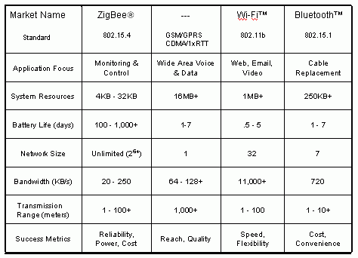
Wireless standards

Slide 73
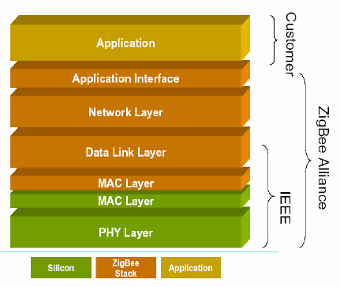
IEEE 802.15.4 and ZigBee
IEEE 802.15.4 Working Group
Defining lower layers of protocol stack: MAC and PHY
ZigBee Alliance
Defining upper layers of protocol stack from network to application

Slide 74
ZigBee overview
ZigBee was created to address the market need for a cost-effective, standards based wireless networking solution that supports low data-rates, low-power consumption, security, and reliability.
ZigBee is the only standards-based technology that addresses the unique needs of most remote monitoring and control and sensory network applications.
The initial markets for the ZigBee Alliance include Home Automation, Building Automation and Industrial Automation.

Slide 75
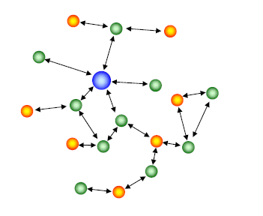
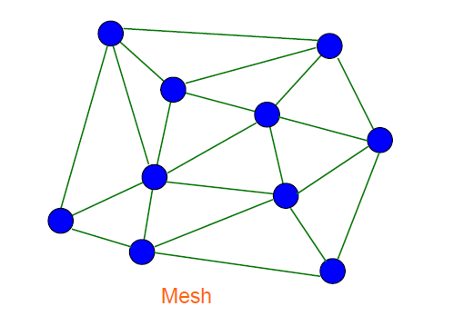
How to achieve low power consumption?
The duty cycle of battery is designed to be very low, resulting in very low average power consumption.
Once associated with a network, a ZigBee node can wake up and communicate with other devices and return to sleep.
Short range operation.
Simple but flexible protocol.

Slide 76
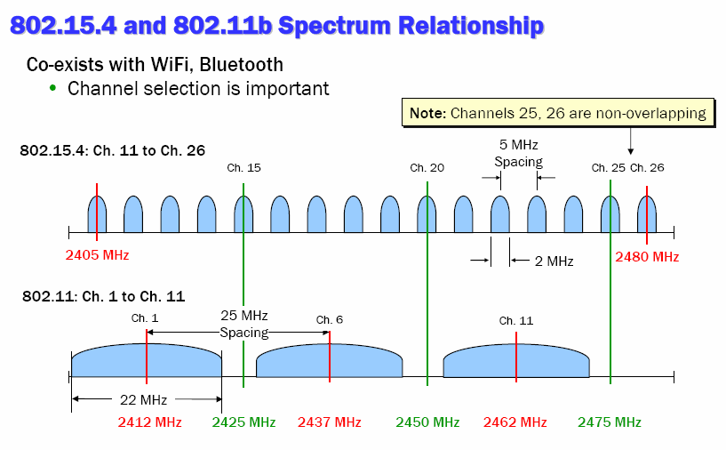
Interference and Coexistence in the 2.4GHz Band

Slide 77
Chapter 4:Local area network Summary
various link layer technologies
LAN model
Ethernet
hubs, switches
VLAN
IEEE 802.11
IEEE 802.15

